Slide 1
Office 365 Development

Slide 2


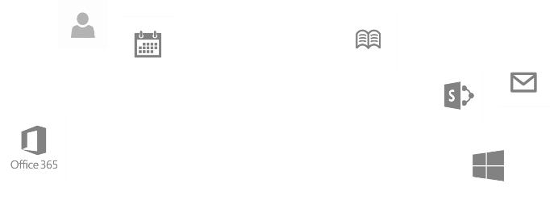
Recap
Introduction to Office 365 development
Module 1: Introduction to Office 365 development
Module 2: Getting started with Apps for Office
Module 3: Getting started with Apps for SharePoint
Module 4: Moving Full Trust Code to the Cloud Using Repeatable Patterns and Best Practices
Module 5: Getting started with the Office 365 APIs
dev.office.com/training

Slide 3
Course Agenda
Deep Dive into Integrating Office 365 APIs with Web Applications
Module 1: Deep Dive into Azure AD with the Office 365 APIs
Module 2: Deep Dive into Office 365 APIs for Calendar, Mail, and Contacts
Module 3: Deep Dive into Office 365 APIs for OneDrive for Business
Module 4: Deep Dive into Office 365 APIs for SharePoint Site services
Module 5: Deep Dive into Office 365 APIs for Yammer services
Module 6: Deep Dive into Office 365 APIs for Office Graph
Module 7: Deep Dive into Office 365 APIs for OneNote services

Slide 4
Deep Dive into Azure AD with the Office 365 APIs
Speaker
Speaker

Slide 5

Agenda
Introduction
OAuth Basics & Authentication Flow
App Registration and Authentication
Office 365 Discovery Service

Slide 6
Introduction

Slide 7
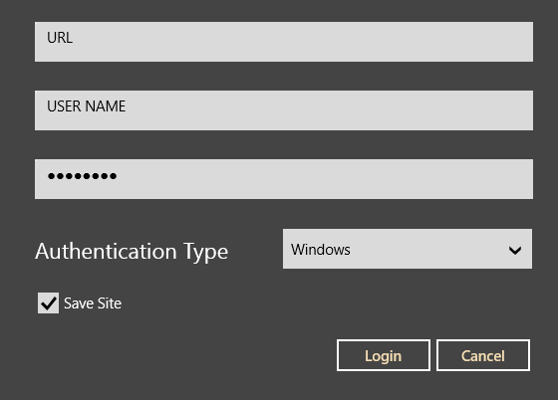
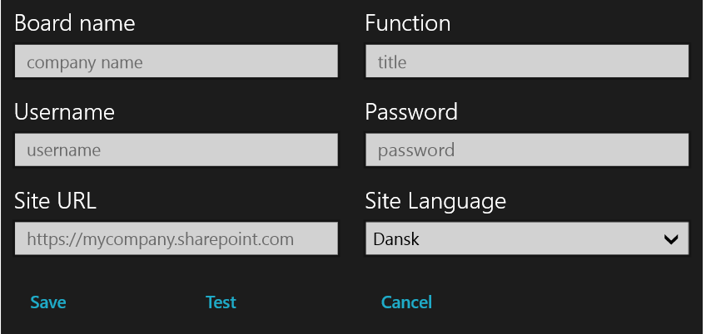
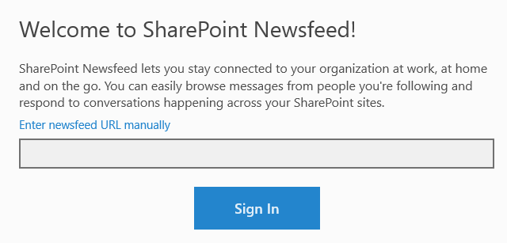
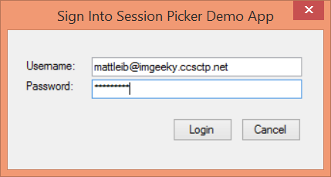
Office 365 Device Apps
Notes:
Prior to the release of the Office 365 APIs, device apps had to prompt users for credentials for the service, and in some cases the location of the resources.
Storing credentials is very risky, and a worst practice.

Slide 8
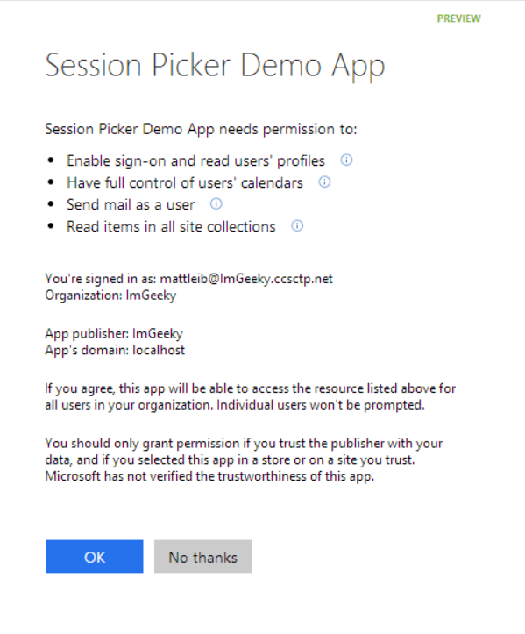
Azure AD OAuth in Office 365 Preview
Single auth flow for Office 365
Azure AD Graph, Exchange, SharePoint
Device apps and web sites
Admin and end-user consent
Secure protocol
OAuth 2.0
No capturing user credentials
Fine-grained access scopes
Supports MFA and federated user sign-in
Long-term access through refresh tokens
Notes:
With the Office 365 APIs, which leverage the Azure AD Oauth service, device apps no longer need to store user credentials.
Azure AD has implemented a “Common Consent” dialog, providing a consistent interface for permission grants.
Typically, OAuth is used to access a single resource. Common Consent is unique in that it can provide a token to Exchange Mail/Calendar/Contacts as well as SharePoint lists and files in OneDrive .

Slide 9
OAuth Basics and Authentication Flow

Slide 10
Authentication to Office 365 APIs using Resource Id
Azure AD Authorization
Endpoint
Azure AD Token
Endpoint
Native Application
Office 365 API
Request authorization code
Sign-in via browser pop-up
Return authorization code
Redeem authorization code and acquire access token for Office 365 resource
Return access token and refresh token
Call Office 365 API using the access token
Return Http Response
Notes:
** This slide has animations **
To facilitate the issuance of tokens for multiple resources, a different approach is required.
Instead of requesting an access token from the Authorization Endpoint, an authorization code is requested. The Resource Id for which a token is desired in included in the call to the Authorization Endpoint. The Authorization Endpoint will ensure the user is logged in, and will present the Common Consent dialog that lists the permissions requested by the application.
The authorization code is redeemed at the new Token Endpoint, which returns an access token and a refresh token. The token is issued for the resource identified in the authorization code request.
The access token is used to access the resource. The access token represents the user’s permissions to the resource. The application permission is granted during common consent.

Slide 11
demo
OAUTH AUTHENTICATION FLOW
Notes:
Using the browser and Fiddler, the authentication and token issuance flow can be demonstrated without writing code. Exercise 2 in the lab has detailed steps. (Exercise 1 is a pre-requisite.)

Slide 12
App Registration & Authentication

Slide 13
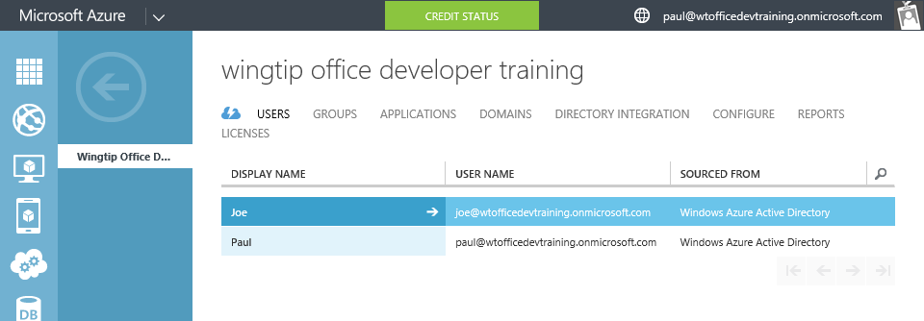
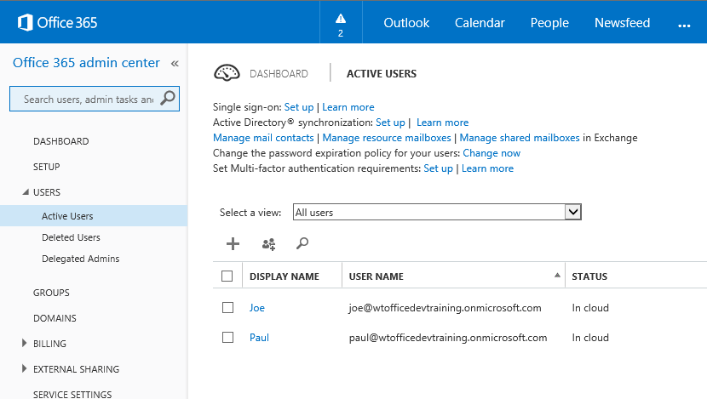
Azure Active Directory (Azure AD)
Included in Office 365 Subscription
Users & Groups managed in Office 365 Portal
Changes persisted in Azure AD
Notes:
Although an Azure AD is included with Office 365, accessing it via the Azure Management Portal requires a “sign-up.” However, there are no charges from Azure for using AD. (Charges will occur if other services are used.)

Slide 14
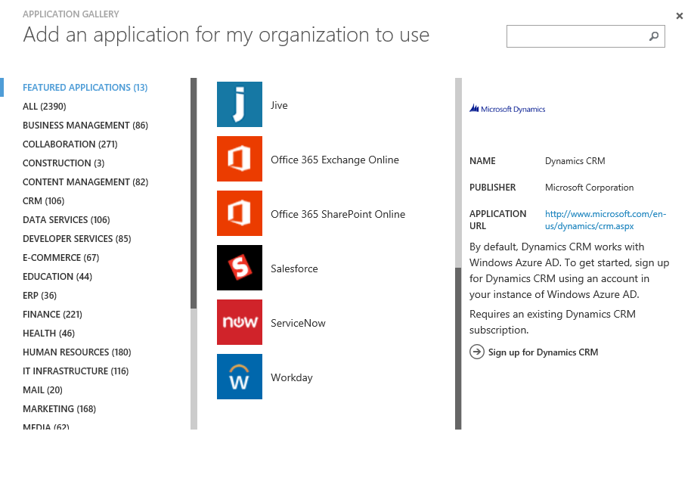
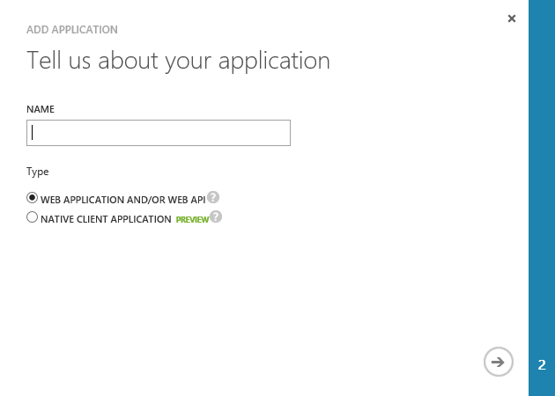
Application Registration
Application Types
Custom developed
Third-party, published in the gallery
Office 365 SharePoint, Exchange
Dynamics CRM
Thousands of others
Custom Applications
Web Application and/or WebAPI
Native Client

Slide 15
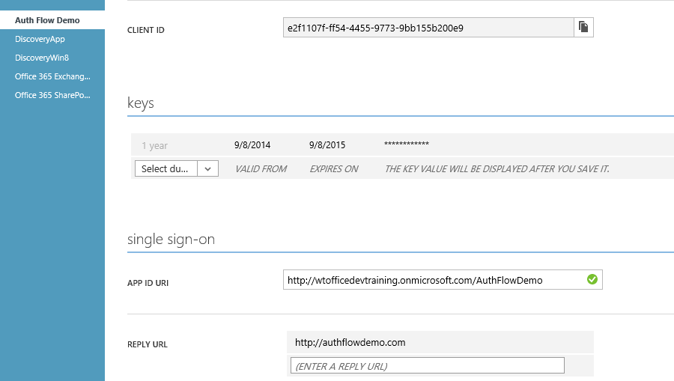
Custom Application Registration
Key information
Client ID
Keys (aka Client Secret)
Redirect /Sign-On URI

Slide 16
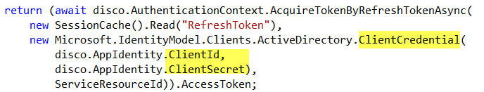
Application Authentication
App Authentication uses Client ID/Secret
Protect this information just as you would a user name / password
Notes:
In this snippet from Module 3653-4, notice the Client ID and Client Secret are used to create a credential object.

Slide 17
Office 365 Discovery Service

Slide 18
O365 Discovery Service
Returns a collection of endpoints specific to current user
Intended as the starting point for application
1. Sign-In
2. Get authorized
3. Discover endpoints for resource
4. Get Token
5. Access resource
API Libraries simplify necessary code

Slide 19
demo
OFFICE 365 DISCOVERY SERVICE
Notes:
The DiscoveryWin8 app demonstrates the results of the API steps. The App *does not* use the O365 libraries, rather uses raw calls to the endpoints. This demo is intended to show the underlying functionality rather than hide it behind the library.
Original demo is at http://code.msdn.microsoft.com/Office-365-APIs-How-to-use-609102ea
Demo is also in the Completed Projects folder

Slide 20
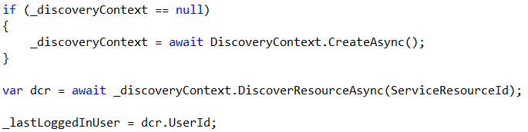
Office 365 API Libraries
How it works
Mail / Calendar / Contacts
Create a Discovery Context
Call DiscoverResourceAsync() method, passing a string that identifies the resource required
Returns the UserId and TenantId
* Does not return an endpoint, since this a static endpoint (https://outlook.office365.com) *
Notes:
This slide is a quick introduction to the libraries. Following modules explore these in depth.

Slide 21
Office 365 API Libraries
How it works
My Files / SharePoint Sites
Create a Discovery Context
Call DiscoverCapabilityAsync() method, passing a string that identifies the resource required
Returns the UserId, TenantId and Endpoint
Notes:
This slide is a quick introduction to the libraries. Following modules explore these in depth.

Slide 22
Troubleshooting

Slide 23
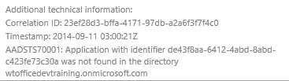
Troubleshooting Errors in Auth flow
Login Errors
Shown on web page
Fiddler
Shows response / request from apps running on local computer
Review Response as JSON
Authentication errors (invalid values)
{"error":"invalid_grant","error_description":"AADSTS70002: Error validating credentials. AADSTS50011: The reply address 'http://localhost:40298/Home/Discovery' is not valid.}

Slide 24
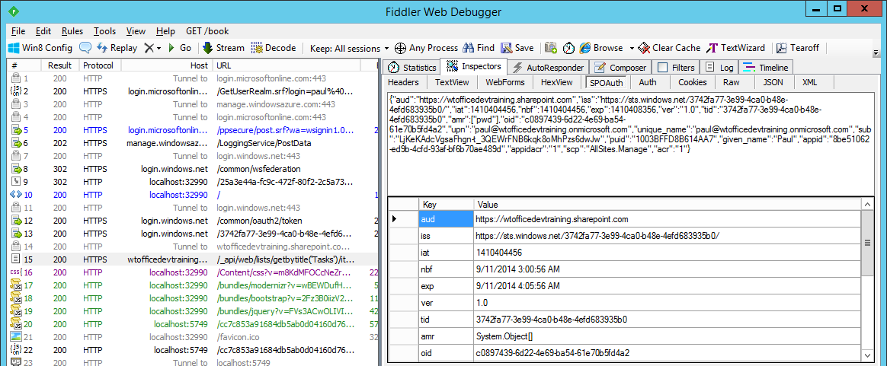
Troubleshooting Tokens
Fiddler
Extension to view SharePoint 2013 App Tokens
http://blogs.msdn.com/b/kaevans/archive/2013/08/25/creating-a-fiddler-extension-for-sharepoint-2013-app-tokens.aspx
Online
Paste token in web page
http://jwt.io/

Slide 25
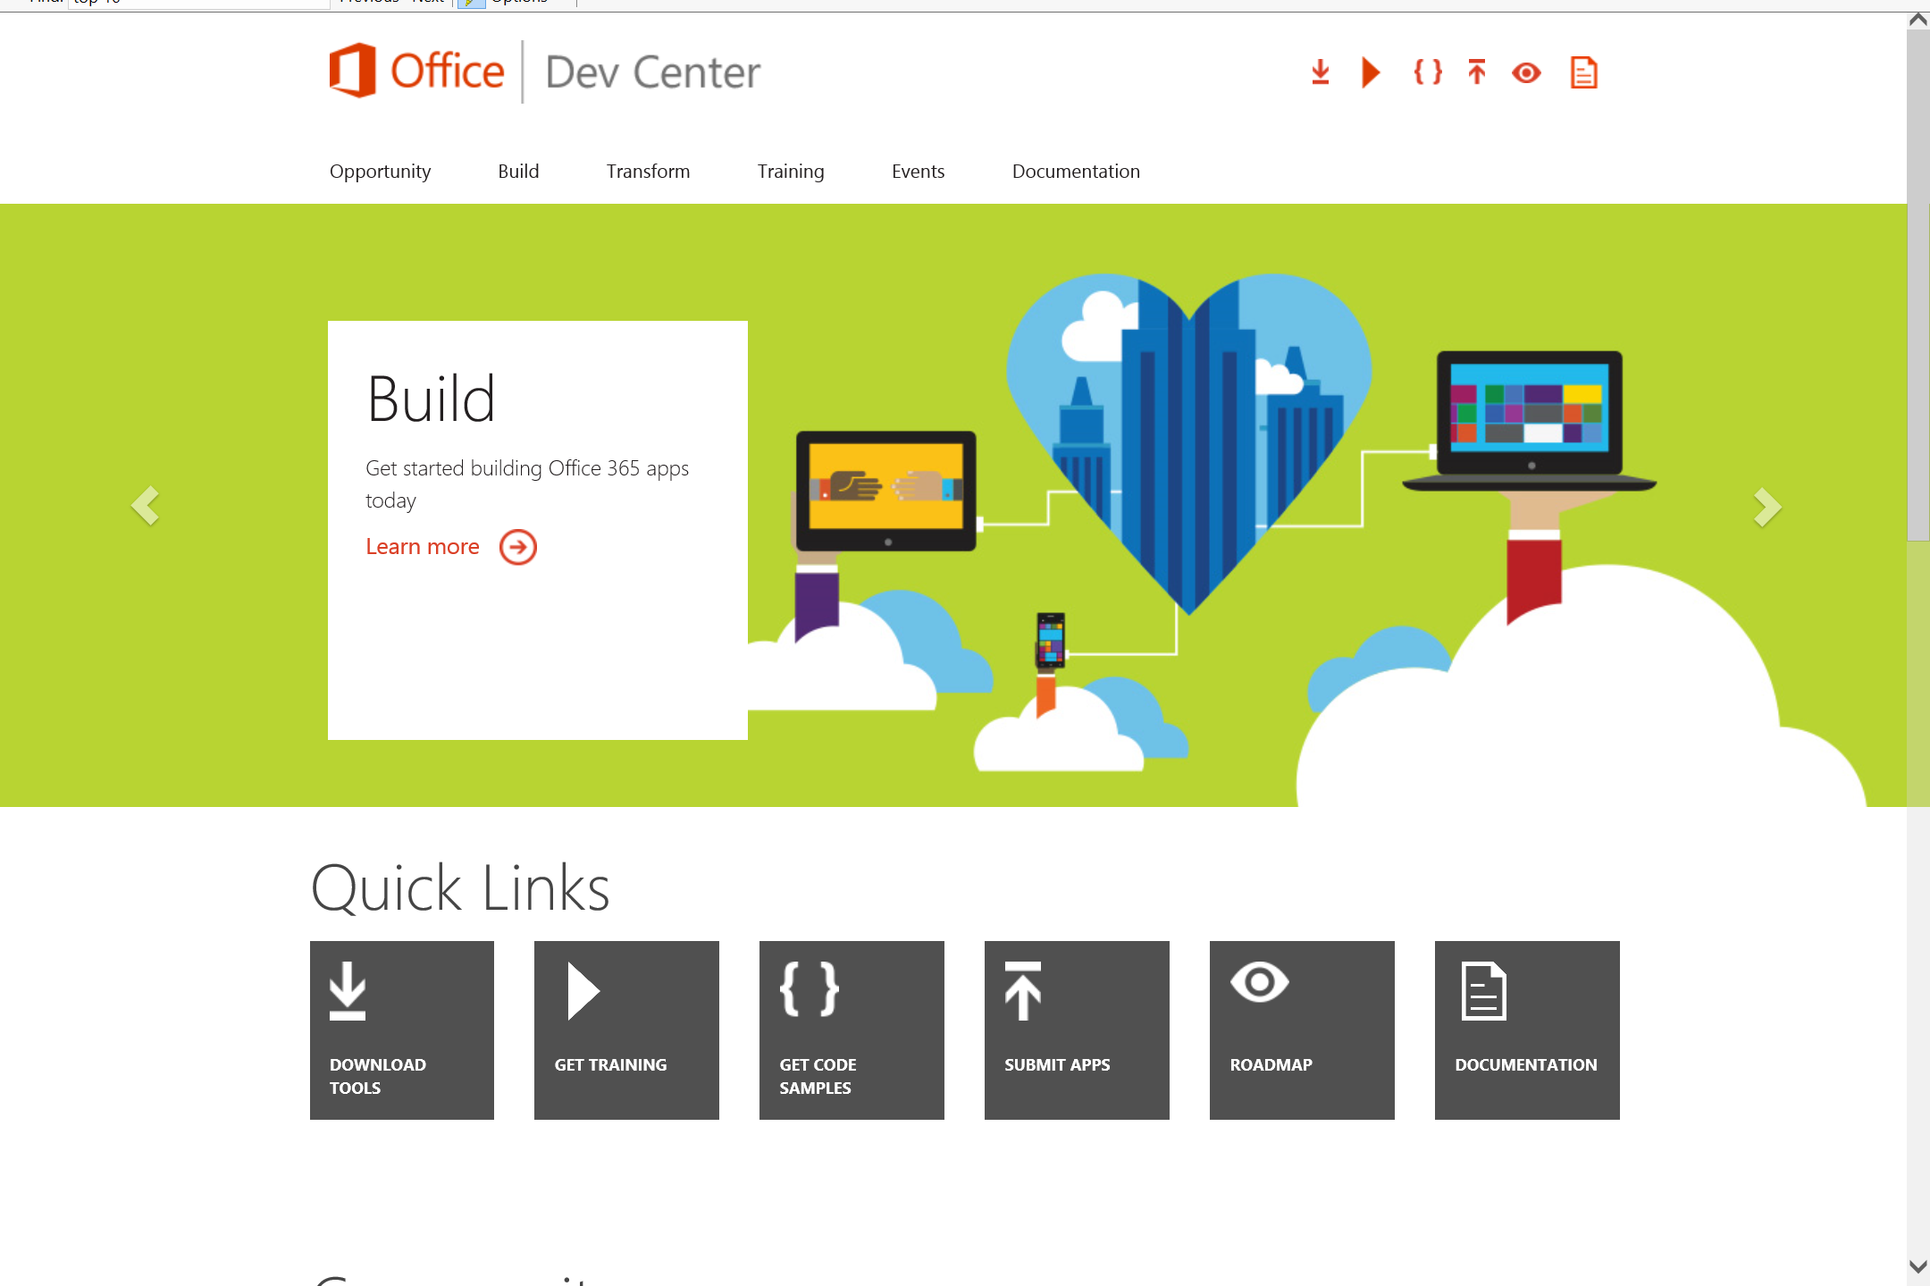
Dev.
Office
.com
One stop shop for Office Developer Platform

Slide 26
Calls to action
Explore our developer center
http://dev.office.com
Jumpstart into our training http://dev.office.com/training
Play with our code samples http://dev.office.com/code-samples
Get answers
http://aka.ms/AskSharePoint
http://aka.ms/AskOffice
Give feedback Drive our roadmap http://aka.ms/OfficeDevFeedback

Slide 27


Transform your code Providing App Model Patterns for common Full Trust Code scenarios
60+ Visual Studio projects Common scenarios
Branding
Site provisioning
Remote event receivers
Large file support
Taxonomy driven navigation
And much more…
Contribute
Open source coming soon!
Developer
Patterns & Practices
aka.ms/OfficeDevPnP

Slide 28
Microsoft Virtual Academy courses
2014
2015
Deep Dive into integrating Office 365 APIs with your mobile device development
Deep dive into the building blocks and services of the SharePoint platform
Deep Dive into integrating Office 365 APIs with your standalone web application development
Introduction to Office 365 Development
Deep Dive into the Office 365 App Model
Deep Dive into Office 365 Development on non-Microsoft Stack
Shipping your Office 365 App to the Office Store
Aug
Sept
Oct
Nov
Dec
Jan
Feb

Slide 29

© 2014 Microsoft Corporation. All rights reserved. Microsoft, Windows, and other product names are or may be registered trademarks and/or trademarks in the U.S. and/or other countries.
The information herein is for informational purposes only and represents the current view of Microsoft Corporation as of the date of this presentation. Because Microsoft must respond to changing market conditions, it should not be interpreted to be a commitment on the part of Microsoft, and Microsoft cannot guarantee the accuracy of any information provided after the date of this presentation. MICROSOFT MAKES NO WARRANTIES, EXPRESS, IMPLIED OR STATUTORY, AS TO THE INFORMATION IN THIS PRESENTATION.

